Slide 1
My Perimeter, Area and Volume Interactive Notebook
Name
Class
Term 3 Semester 2

Slide 2
Contents
Formula Page
Page
Date
Description
2
3

Slide 3
Tasks
24
7
30
Essential Question
Questions
Notes
Summary
10
11

Slide 4
24
7
30
Area
Date
EQ – How we can use formulas to find areas of different shapes?

Slide 5
Quickwrite
On the LHS of your INB, spend the next 3 minutes writing everything you know about area.
What is it?
How is it different from perimeter?
Give an example of area
Etc...

Slide 6
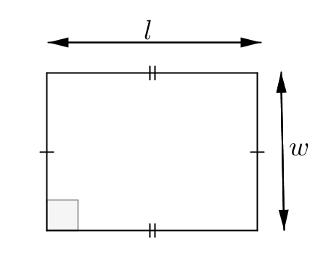
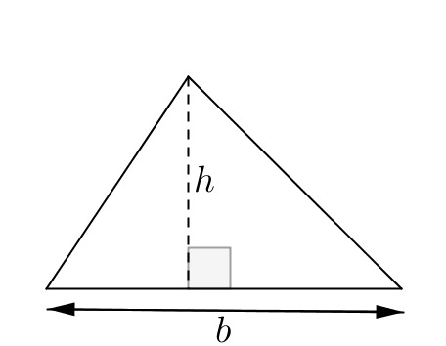
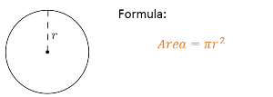
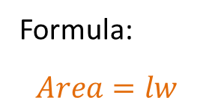
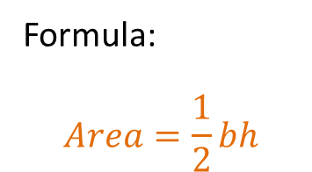

24
7
30
Area
Date
EQ – How we can use formulas to find areas of different shapes?
The area of a shape is the amount of space exists inside a 2 dimensional space. The 3 basic shapes are;
Area of a rectangle
Formula:
$$Area=lw$$
Formula:
$$Area=\frac{1}{2}bh$$
Area of a triangle
Area of circle
$$π≈3.14$$

Slide 7
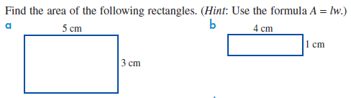
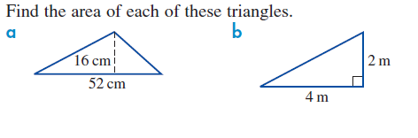
Examples
Let’s try together.
Find the area of these 2 circles.
2cm

Slide 8

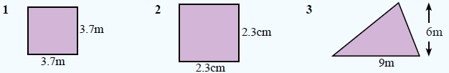
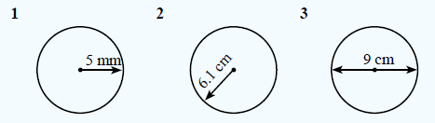
Your turn.
Use pi = 3.14

Slide 9
24
7
30
Area
Date
EQ – How we can use formulas to find areas of different shapes?
How do we find the area of more complex shapes like the one below?
7cm
Rectangle
Triangle
20cm
5cm
We break it into it’s composite shapes. What two shapes is the above shape made up of?

Slide 10
24
7
30
Area
Date
EQ – How we can use formulas to find areas of different shapes?
The shape below can be split into 2 pieces, a rectangle and a triangle
+
7cm
7cm
15cm
5cm
To find the area of the whole shape, we find the area of the 2 shapes and add them together.
A=1/2 x base x height
= 0.5 x 7 x 5 cm
= 17.5 cm²
A=length x width
= 7 x 15 cm
= 105cm²
Total area = area of rect. + area of triangle
= 105 + 17.5 = 122.5cm²

Slide 11
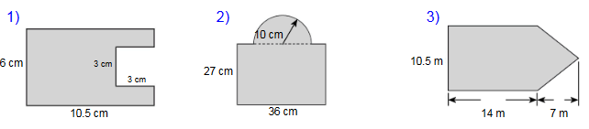
Try these on the LHS of your INB

Slide 13
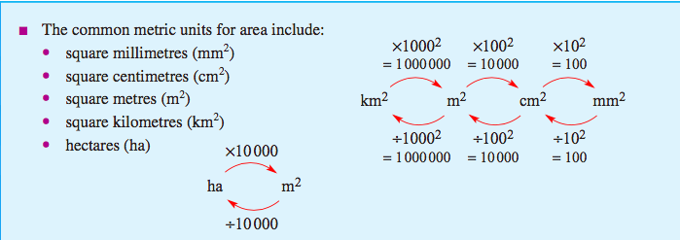
Remember your Conversion Caterpillar!

Slide 14
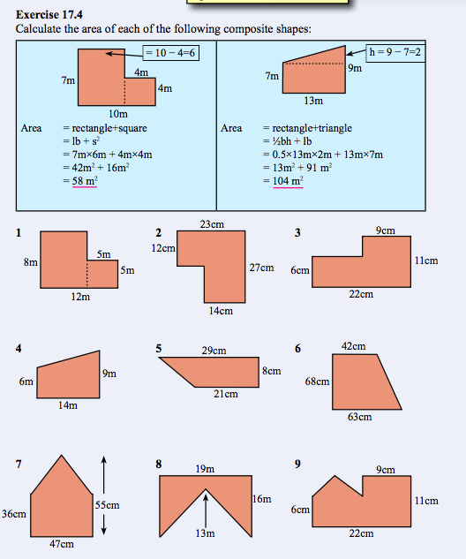
Exercise 17.4 on
page 232 of Dwyer

